Slide 1
Starbucks, which area makes it good?
Zonghao Zou

Slide 2
Business, Customers, Location
Many Starbucks stores opened in NYC.
If you want to open another store, which area should you look into?
If you want to enjoy good services, which area should you look into?

Slide 3
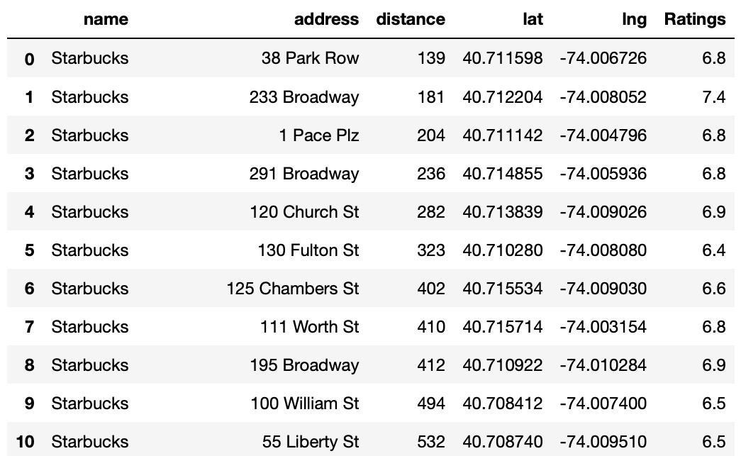
Data acquisition and cleaning
Data was acquired through Foursquare
Search_query = ‘Starbucks’, address = ‘New York, NY’
Important features:
Name, address, distance, latitude, longitude, and rating.

Slide 4
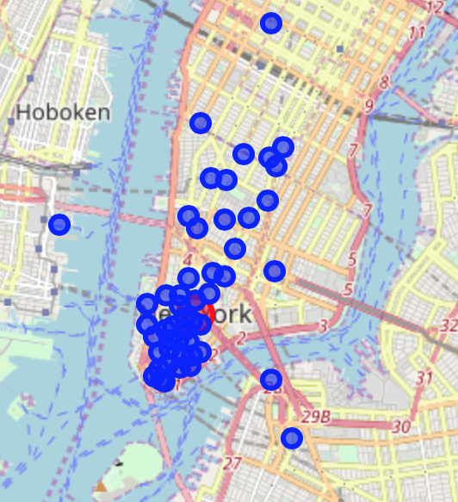
First look at the data

Slide 5
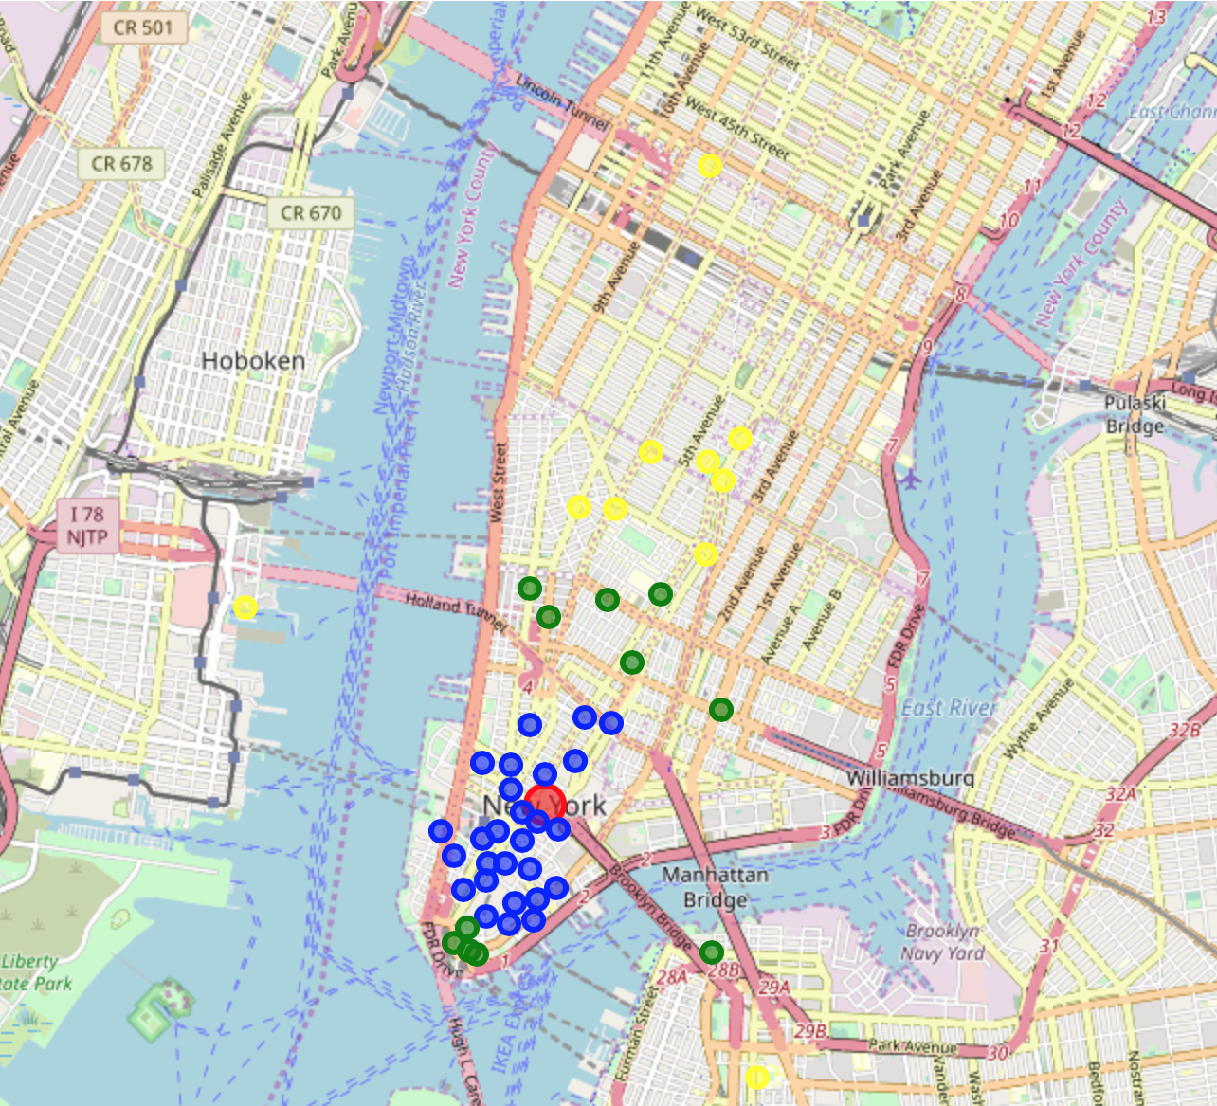
Clustering by distance (1000, 2000,more)

Slide 6
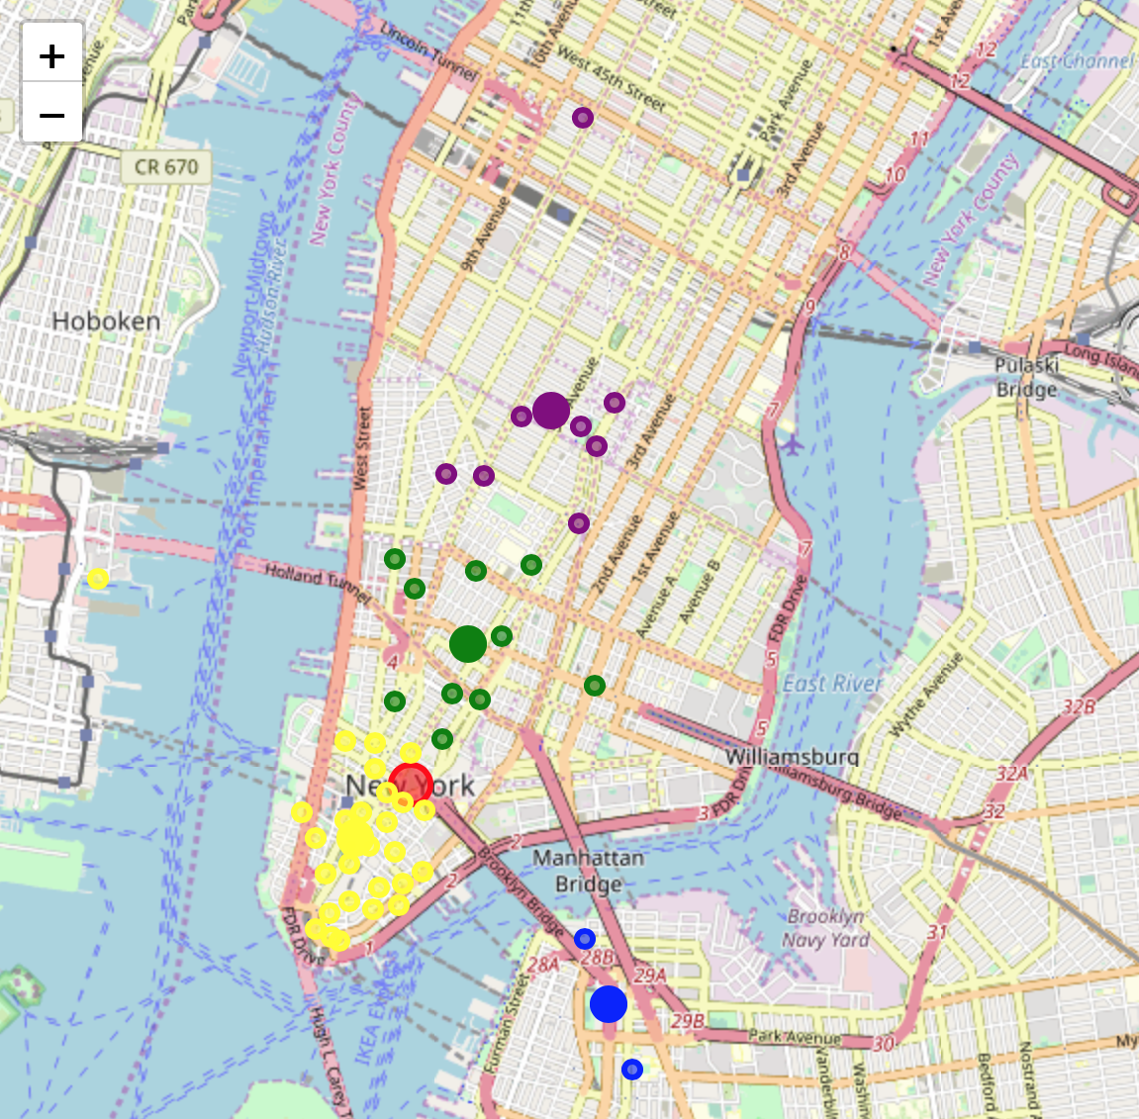
Clustering by latitude and longitude

Slide 7
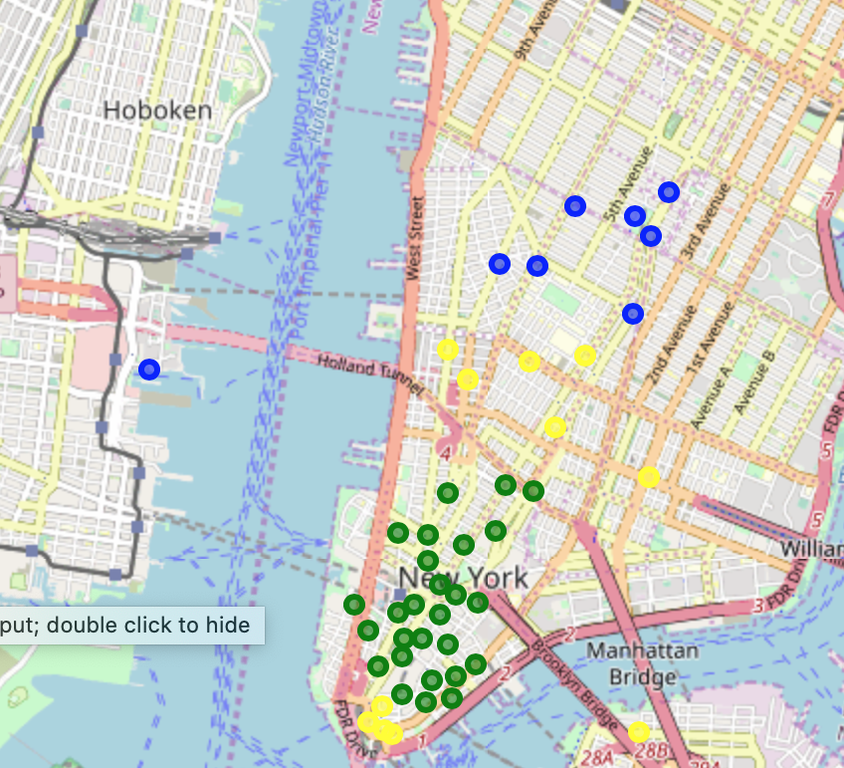
Clustering by distance and rating

Slide 8
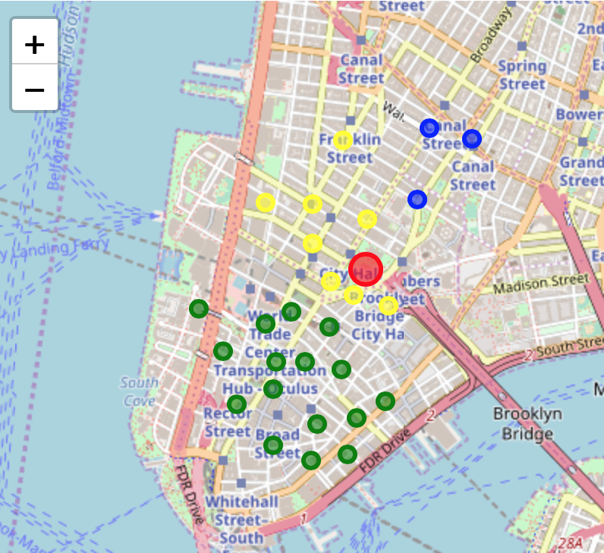
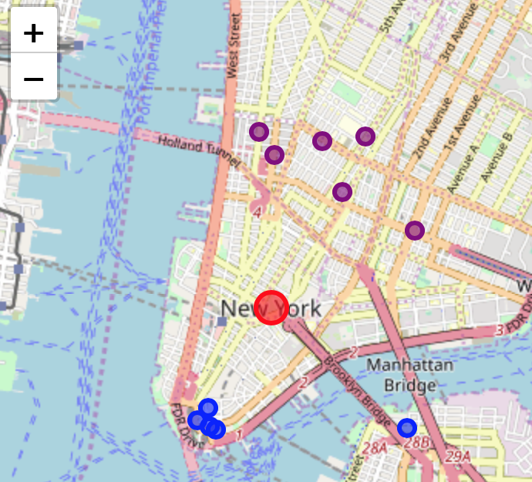
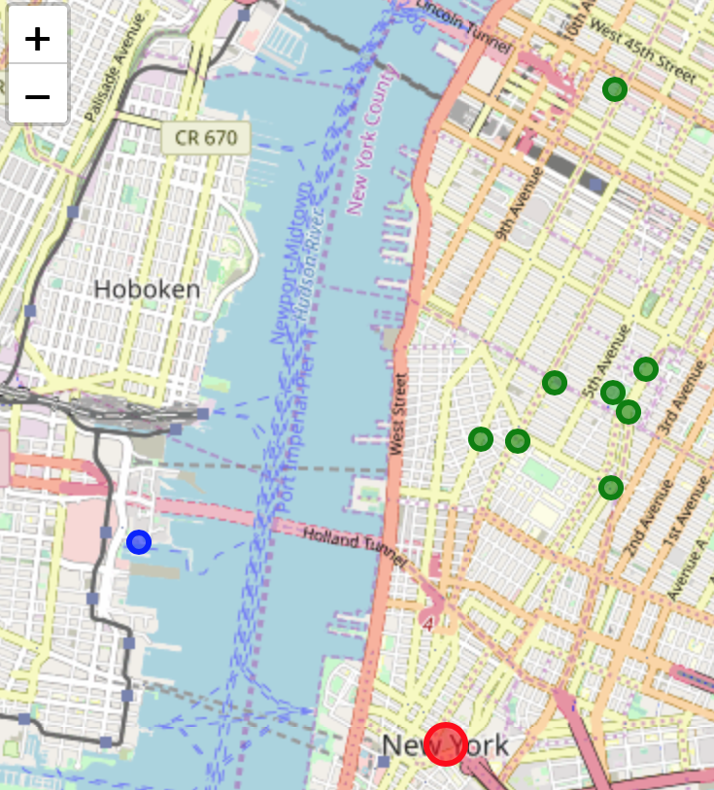
Clustering by distance, then by latitude and longitutde

Slide 9
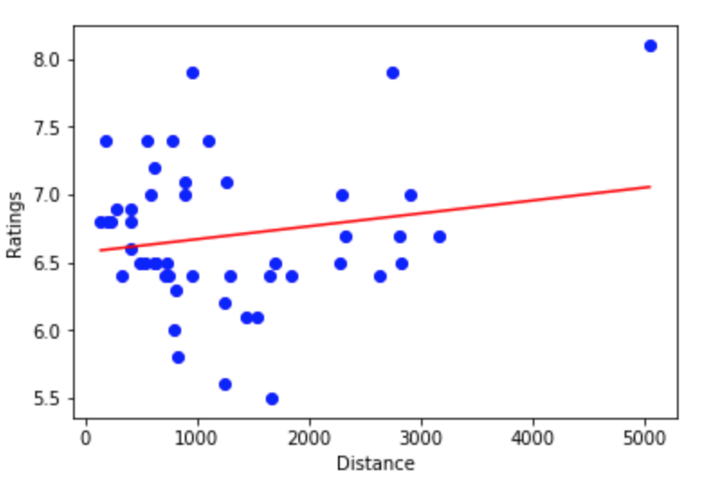
Regression between distance and rating

Slide 10
Conclusion
Two areas are great for opening Starbucks:
2000 meters North of NYC
500 meters South of NYC
Data that can further help the analysis:
Sales of each stores
Expenses
More store data

Slide 11
Thank you!

